Slide 1
Simplifying Radicals
Objective: Students will be able to take a non-perfect radical and simplify it. They will be able to identify any perfect squares and use those to create a simplified answer.

Slide 2
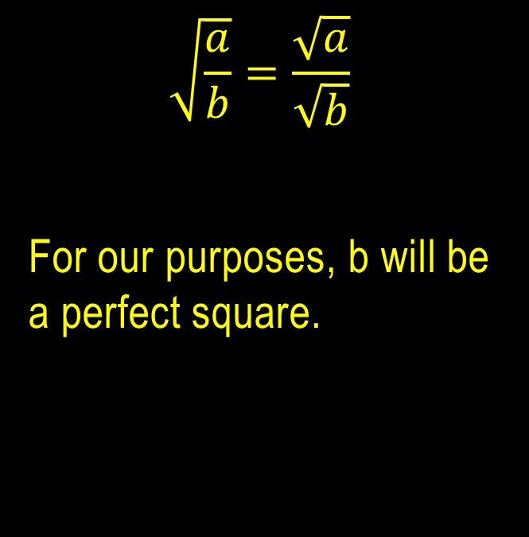
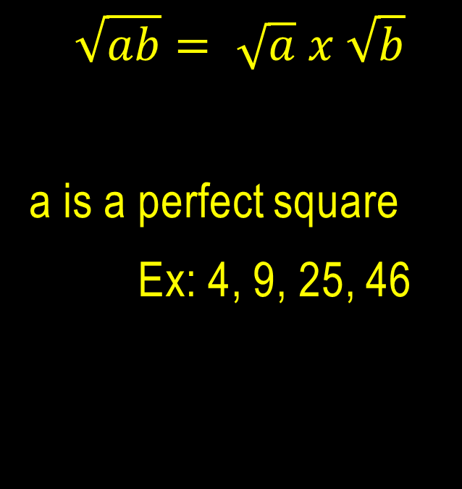
Notes
$$\sqrt{ab}= \sqrt{a} x \sqrt{b}$$
a is a perfect square
Ex: 4, 9, 25, 46
$$\sqrt{\frac{a}{b}}=\frac{\sqrt{a}}{\sqrt{b}}$$
For our purposes, b will be a perfect square.

Slide 3
Simplify the radicals - T
$$\sqrt{12}$$
$$\sqrt{32}$$
$$\sqrt{75}$$
$$\sqrt{50}$$

Slide 4
Simplify the radicals - sT
$$\sqrt{48}$$
$$\sqrt{8}$$
$$\sqrt{80}$$
$$\sqrt{79}$$

Slide 5
Simplify the radicals - T
$$\sqrt{\frac{20}{9}}$$
$$5\sqrt{\frac{1}{25}}$$
$$\sqrt{\frac{5}{16}}$$
$$\sqrt{\frac{16}{25}}$$

Slide 6
Simplify the radicals - sT
$$\sqrt{\frac{4}{9}}$$
$$6\sqrt{\frac{1}{36}}$$
$$\sqrt{\frac{12}{25}}$$
$$\sqrt{\frac{44}{25}}$$

Slide 7
Simplify the radicals - T
$$4\sqrt{25}$$
$$\frac{1}{4}\sqrt{32}$$
9$\sqrt{100}$

Slide 8
Simplify the radicals - sT
$$−2\sqrt{27}$$
6 $\sqrt{\frac{5}{9}}$
$$\frac{1}{3}\sqrt{63}$$

Slide 9
Homework (simplify the following)
1. $\sqrt{44}$ 2. $\sqrt{54}$ 3. $\sqrt{18}$
4. $\sqrt{56}$ 5. $\sqrt{27}$ 6. $\sqrt{63}$
7. $\sqrt{200}$ 8. $\sqrt{90}$ 9. $\sqrt{\frac{4}{16}}$
10. $\sqrt{\frac{9}{49}}$ 11. $\sqrt{\frac{4}{25}}$ 12. $\sqrt{\frac{81}{100}}$
13. $\sqrt{\frac{36}{25}}$ 14. $\sqrt{\frac{7}{9}}$ 15. $\sqrt{\frac{5}{4}}$

