Slide 1
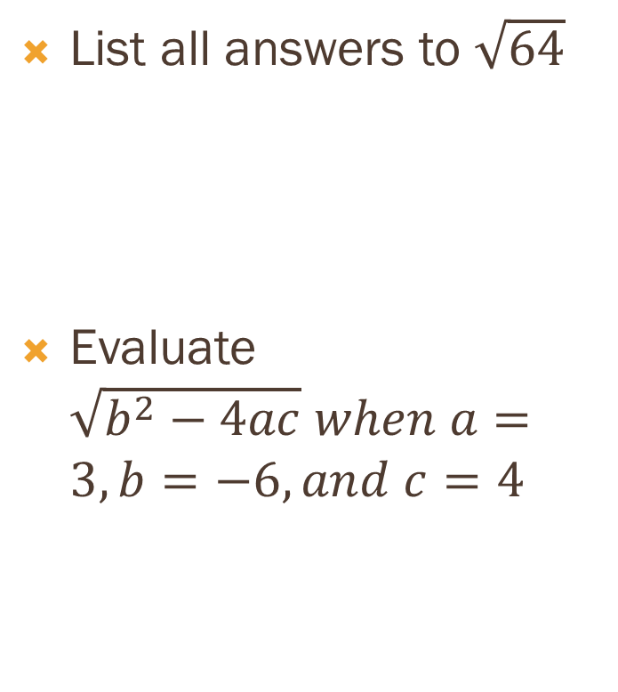
Review
List all answers to $\sqrt{64}$
Evaluate $\sqrt{b^{2}−4ac} when a=3, b=−6, and c=4$
Solve equation or write no solution. If not integer, leave as radical expression
y² + 19 = 33

Slide 2
9.2 Simplifying Radicals

Slide 3

Notes
Product Property: $\sqrt{ab}=\sqrt{a} x \sqrt{b}$
Ex:$\sqrt{100}=\sqrt{4} x \sqrt{25}$
Quotient property: $\sqrt{\frac{a}{b}}= \frac{\sqrt{a}}{\sqrt{b}}$
$\sqrt{\frac{9}{25}}= \frac{\sqrt{9}}{\sqrt{25}}$
Simplest form when:
No perfect square under radicand other than 1.
No fraction under radicand
No radicals appear in denominator of a fraction.

Slide 4


Use the product property to simplify - T
$\sqrt{80}$
$\frac{1}{4}\sqrt{80}$
$$\sqrt{25} x \sqrt{28}$$

Slide 5


Use product property to simplify - st
$$\sqrt{112}$$
$$\sqrt{27} x \sqrt{18}$$
$$\frac{2}{3}\sqrt{98}$$

Slide 6


Use quotient property to simplify - t
$\sqrt{\frac{25}{100}}$
3$\sqrt{\frac{21}{7}}$
$\frac{\sqrt{90}}{33}$

Slide 7


Use quotient property to simplify - st
$\sqrt{\frac{1}{16}}$
10$\sqrt{\frac{5}{36}}$
21$\sqrt{\frac{48}{49}}$
$\sqrt{\frac{16}{169}}$

Slide 8


Simplify the expression - T
$\sqrt{\frac{72}{64}}$
$\sqrt{17} x \frac{\sqrt{112}}{\sqrt{7}}$
8$\sqrt{153} x \sqrt{196}$

Slide 9


Simplify the expression - st
$\sqrt{\frac{8}{25}}$
5$\sqrt{105} x \sqrt{16}$
$\frac{\sqrt{81} x \sqrt{10} }{\sqrt{5}}$

Slide 10
Wrap up
Questions/Comments
Hw: text pg. 514, #’s: 10-52 evens, 53

