Slide 1
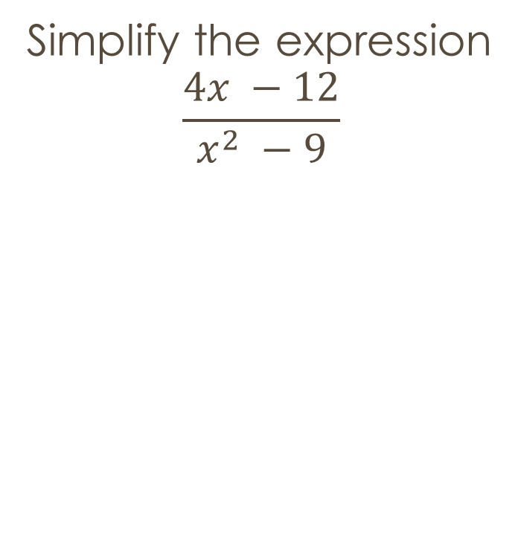
Review
For what values of the variables is the rational expression undefined?
$$\frac{x −7}{x^{2} −49}$$
Simplify the expression
$$\frac{4x −12}{x^{2} −9}$$

Slide 2
Multiplying and Dividing rational expressions

Slide 3


Multiply the expression - T
$$\frac{4x}{3} x \frac{2}{x}$$
$$\frac{9}{2x} x \frac{4x}{15}$$
$$\frac{x+4}{3} x \frac{6}{\begin{aligned}2(x+4) \\ \end{aligned}}$$
$$\frac{x^{2} −25}{12} x \frac{36}{x+5}$$

Slide 4


Simplify the expression - st
$$\frac{3x}{5 } x \frac{10 }{12x}$$
$$\frac{x −3}{x+3 } x \frac{x+3}{x^{2}−9}$$
$\frac{x+4}{x^{2}+5x+4 }$ x (3x + 3)
$$\frac{x+4}{4} x \frac{x −2}{x^{2} −4}$$

Slide 5


Simplify the expression - t
$$\frac{1}{5x} ÷ \frac{3}{20x^{2}}$$
$$\frac{x}{x+3 }÷ \frac{x+11}{x+3}$$
$$\frac{x−3}{6(2x+1)} ÷ \frac{4(x−3)}{3(2x+1)}$$

Slide 6


Simplify - st
$$\frac{5x^{2}}{7} ÷ \frac{10x^{3}}{21}$$
$$\frac{3x+15}{x+4} ÷ \frac{3x}{x+4}$$
$$\frac{x+7}{x} ÷\frac{x+7}{x+3}$$
$$\frac{x+3}{x^{2}+4x+4} ÷ \frac{2x+6}{x+2}$$

Slide 7
Wrap up
Questions/Comments
Acuity:
Hw: text pg. 673, #’s: 12-34 evens

