Slide 1
1.5 Words, equations, tables, and graphs
Objective: students will demonstrate an understanding on how to construct an expression and create a table.

Slide 2
Functions
Function: domain (x) has exactly one range (y).
Function rule: rule applied to domain to get range.
Function table: table lists x-coordinate, rule, and y-coordinate.
input
rule
Output

Slide 3
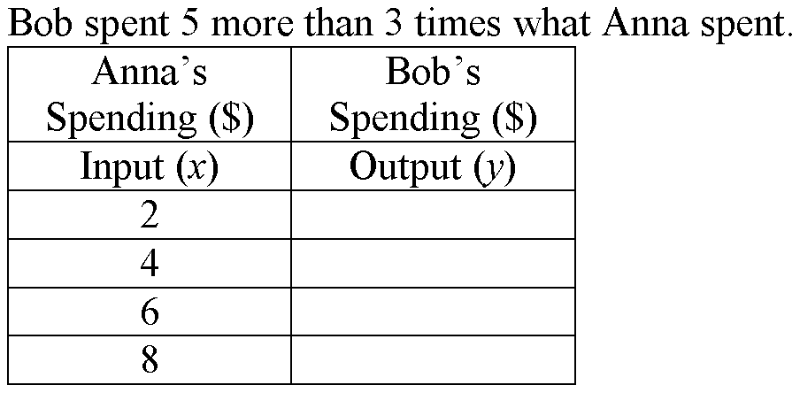
Complete Table, list Domain/range

Slide 4
Complete Table, list domain/range

Slide 5
Make a function table and list the domain and range
Rule: triple a number and add one.
Rule: Each coupon costs $3
input
rule
Output
input
rule
Output

Slide 6
Make a function table and list the domain and range
Rule: phone costs $14 plus .50 per minute.
Rule: Each coupon costs ½ the cost.
input
rule
Output
input
rule
Output
2
4
8
10

Slide 7
Worksheet #1,2
Each copy of a book costs $18 and shipping is $9 per order.
The number of girls at a camp is 17 less than twice the number of boys.

Slide 8
Worksheet #3,4
Tom’s height is 10 inches more than one third of his sister’s height.
The charge for a hotel room is $75 per night plus a $15 booking fee.

Slide 9
Wrap up
Questions and comments
Ic: worksheet

